Slide 1
House Price Prediction
By Avinash Palla

Slide 2
Problem Statement:
To predict price of houses depending on various features.
We are given dataset of house prices with some features like number of bedrooms, number of bathrooms etc.
Our task is to create a model which will predict the price for any new house by looking at the features

Slide 3
Finding the type of Model to build
Supervised Learning- as it contains labels
Regression Task- as we need values
Batch learning Techniques- as the data is stable

Slide 4
Data description
Source of Dataset : Kaggle, Tool used: Jupyter Notebook
Features or Independent variables are:
CRIM per capita crime rate by town
ZN proportion of residential land zoned for lots over 25,000 sq.ft.
INDUS proportion of non-retail business acres per town
CHAS Charles River dummy variable (= 1 if tract bounds river; 0 otherwise)
NOX nitric oxides concentration (parts per 10 million)
RM average number of rooms per
AGE proportion of owner-occupied units built prior to 1940
DIS weighted distances to five Boston employment centres
RAD index of accessibility to radial highways
TAX full-value property-tax rate per $10,000
PTRATIO pupil-teacher ratio by town
B 1000(Bk – 0.63)^2 where Bk is the proportion of blacks by town
LSTAT % lower status of the population
MEDV Median value of owner-occupied homes in $1000’s
`

Slide 5
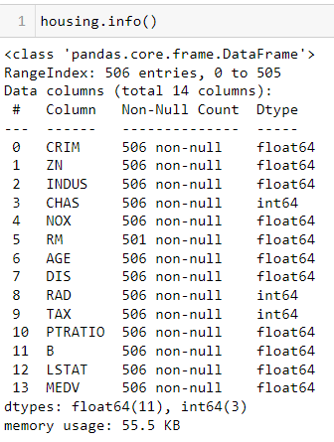
Data approach
Data stored in “housing” variable
Dataset information

Slide 6
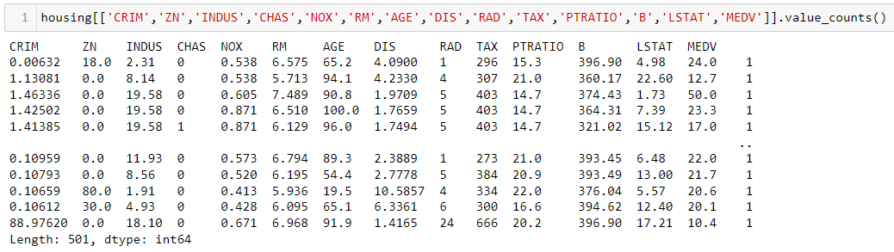
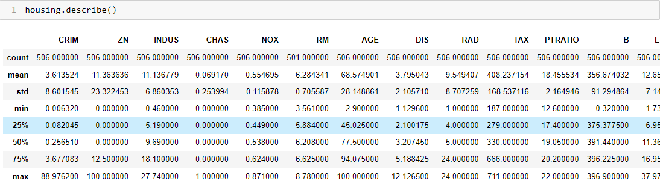
Data approach
Data set value count
5 point data summary

Slide 7
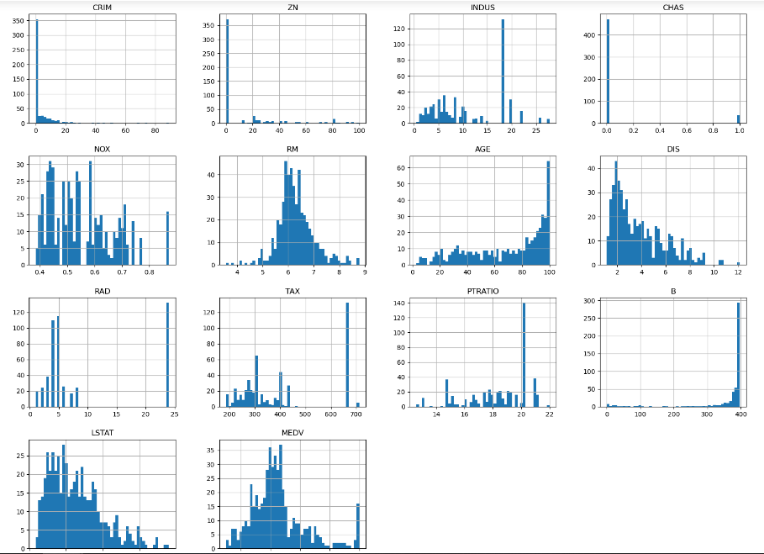
Data approach
Dataset Histogram representation

Slide 8
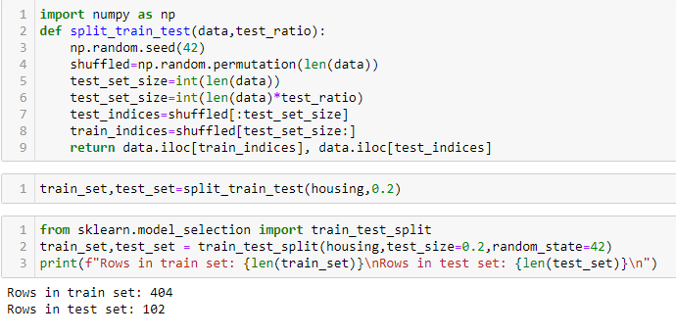
Train-Test Splitting

Slide 9
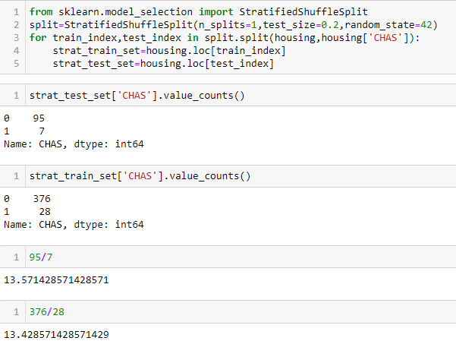
Train-Test Splitting

Slide 10
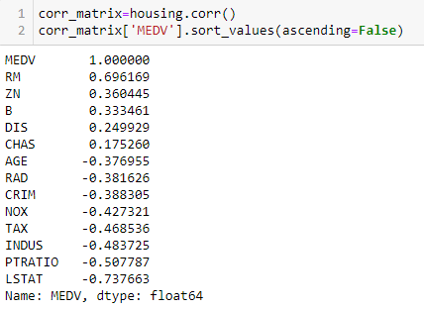
Looking for Correlation

Slide 11
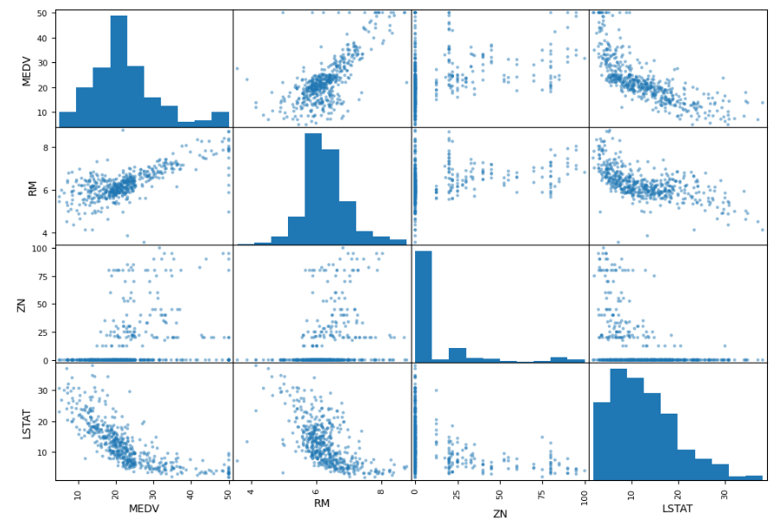
Looking for Correlation

Slide 12
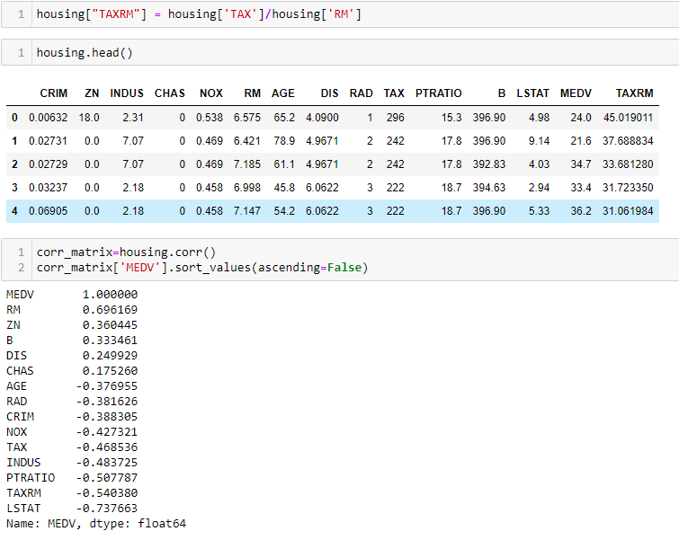
Trying Attribute Combinations

Slide 13
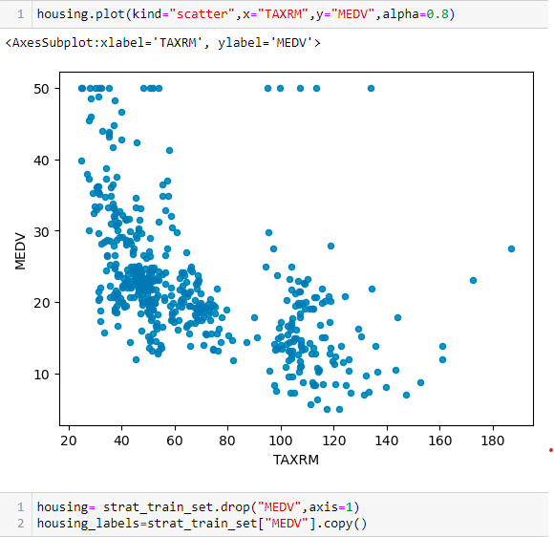
Trying Attribute Combinations

Slide 14
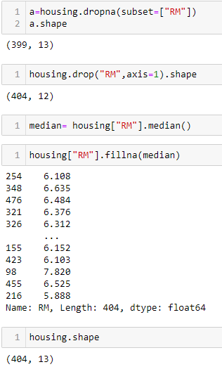
Missing Attributes

Slide 15
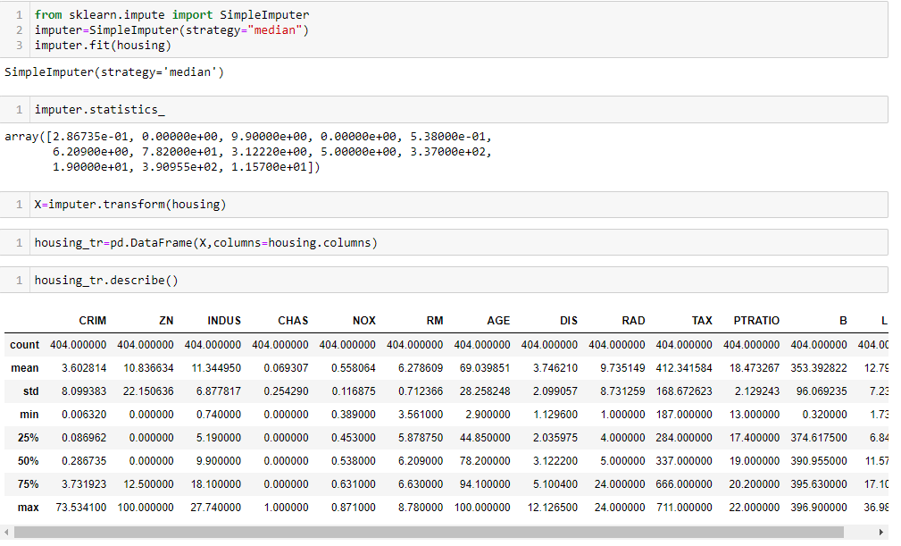
Missing Attributes

Slide 16
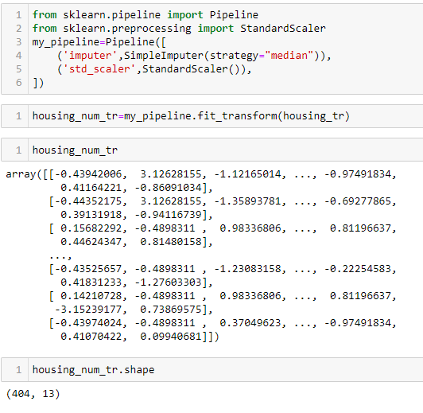
Creating Pipeline

Slide 17
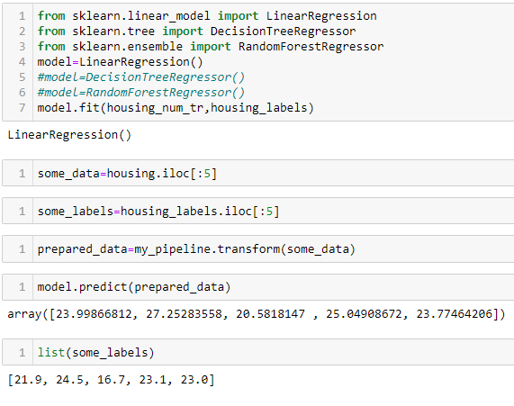
Selecting Desired Model
Linear Regression

Slide 18
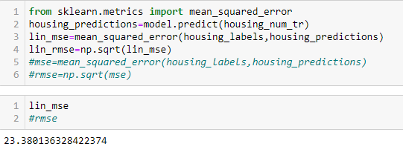
Evaluating the model
Linear Regression

Slide 19
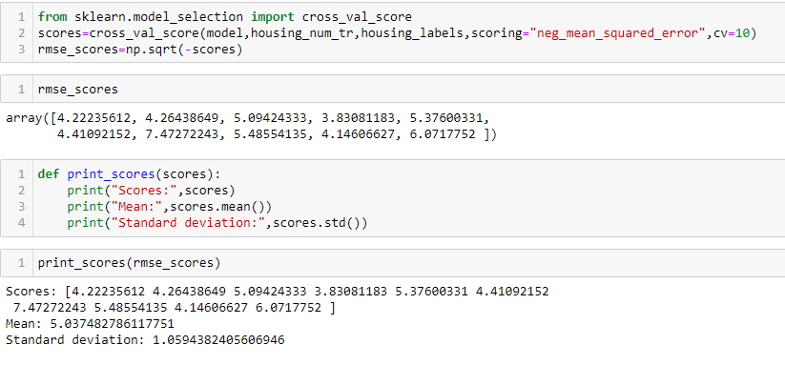
Cross Validation
Linear Regression

Slide 20
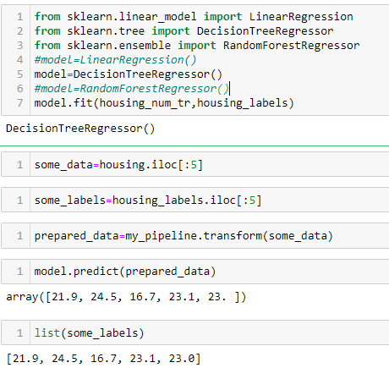
Selecting Desired Model
Decision Tree Regressor

Slide 21
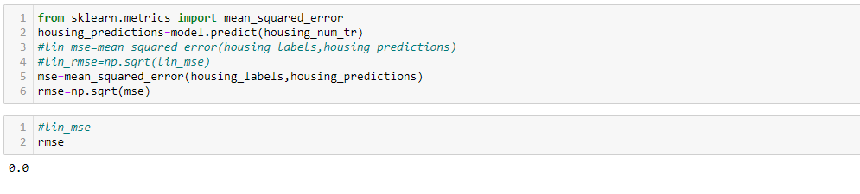
Evaluating the model
Decision Tree Regressor

Slide 22
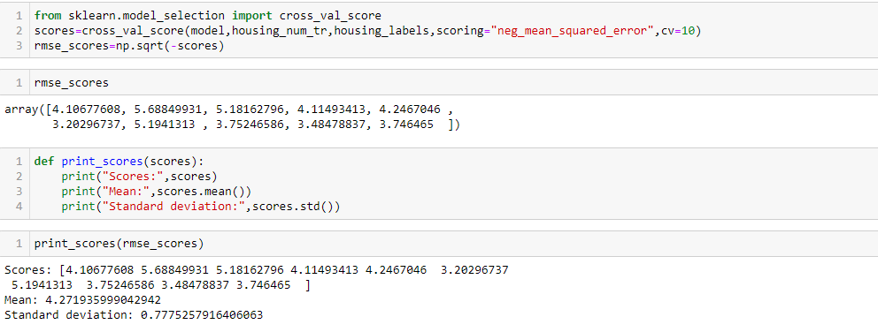
Cross Validation
Decision Tree Regressor

Slide 23
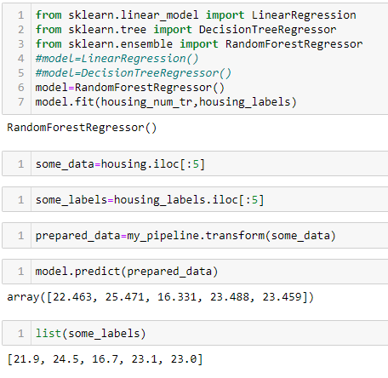
Selecting Desired Model
Random Forest Regressor

Slide 24
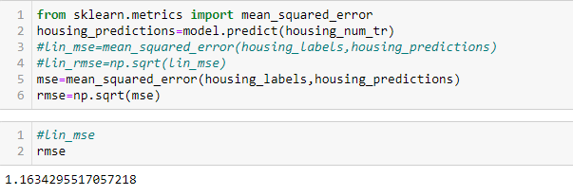
Evaluating the model
Random Forest Regressor

Slide 25
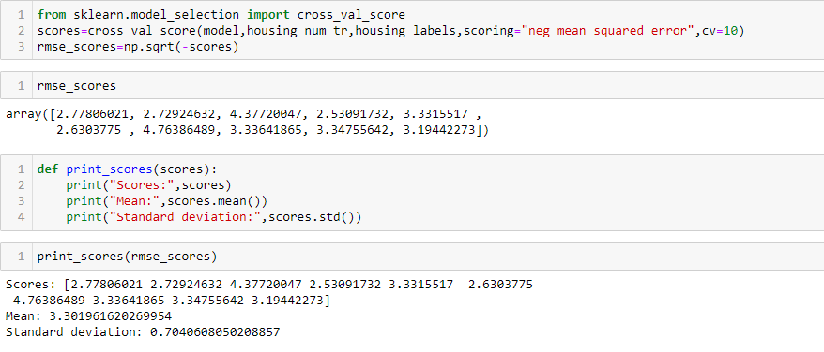
Cross Validation
Random Forest Regressor

Slide 26
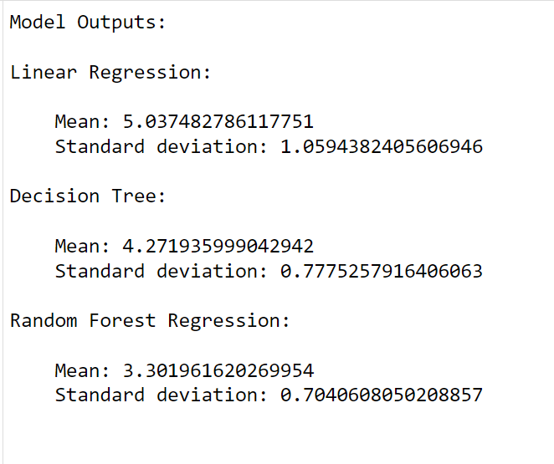
Outputs of different Models

Slide 27
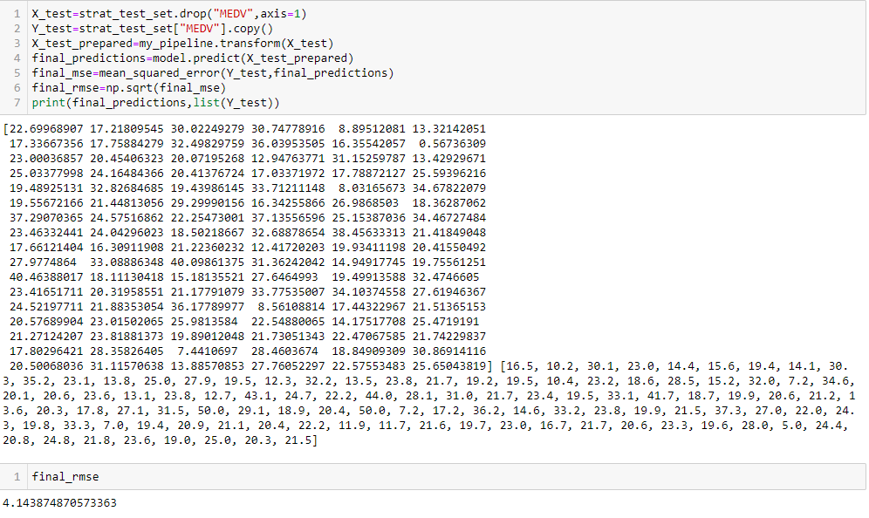
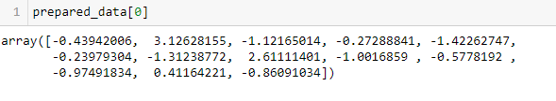
Testing the model in Linear Regression

Slide 28
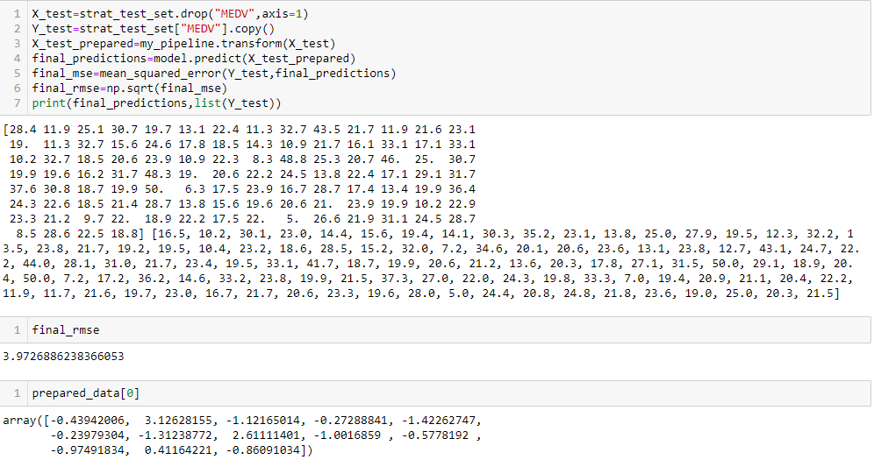
Testing the model in Decision Tree Regressor

Slide 29
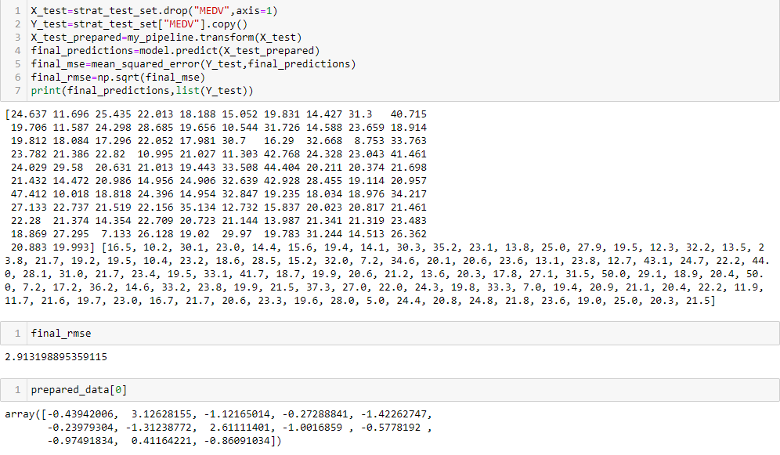
Testing the model in Random Forest Regressor

Slide 30
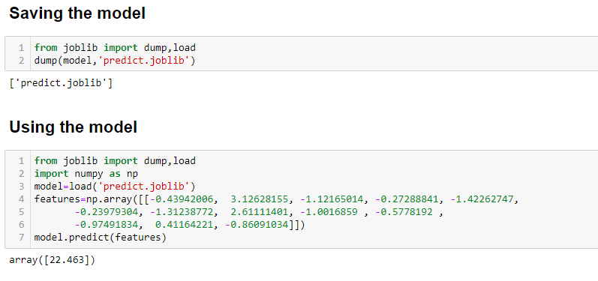
Saving and Using the Model

Slide 31
Thank You

